Slide 1
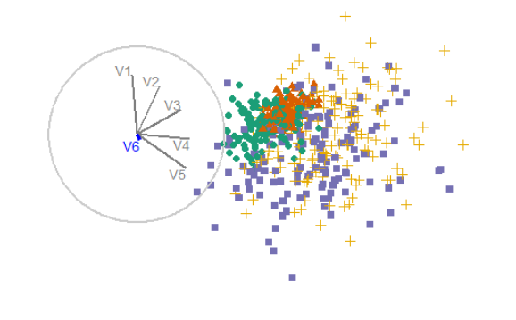
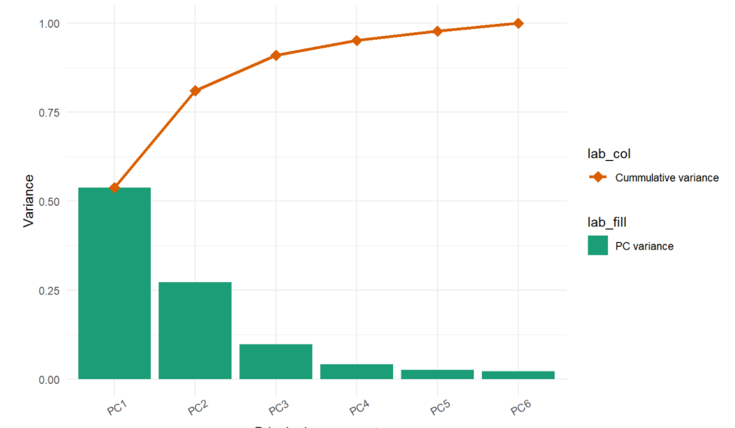
Sketch for stepwise tour
< Remove next variable
Add next variable >
Interaction: radially add or remove the next lowest component based on the defined univariate function
Purpose: explore the marginal change of adding/removing next variable
Setup: produce scree table, find all basis removing latest variable. This ensures you go back to exactly where you were
Limitation: the marginal cost/benefit of the variable is contingent on the starting basis.
In the context of XAI (explainable AI)?

